Slide 1
The Fanosearch Project
Tom Coates
Imperial College London

Slide 2
Fano Varieties
These are atomic pieces of mathematical shapes
1 in dimension 1
10 in dimension 2 (del Pezzo, 1880s)
105 in dimension 3 (Mori-Mukai, 1990s)
Almost nothing is known in dimensions 4, 5, …

Slide 3
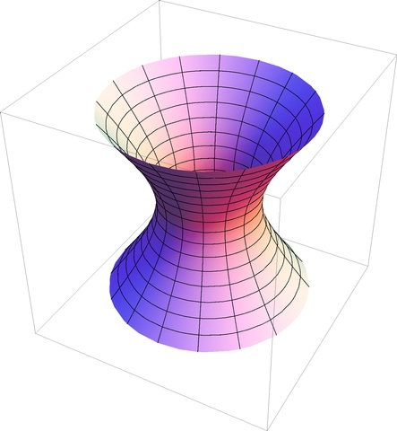
An Example

Slide 4
An Example

Slide 5
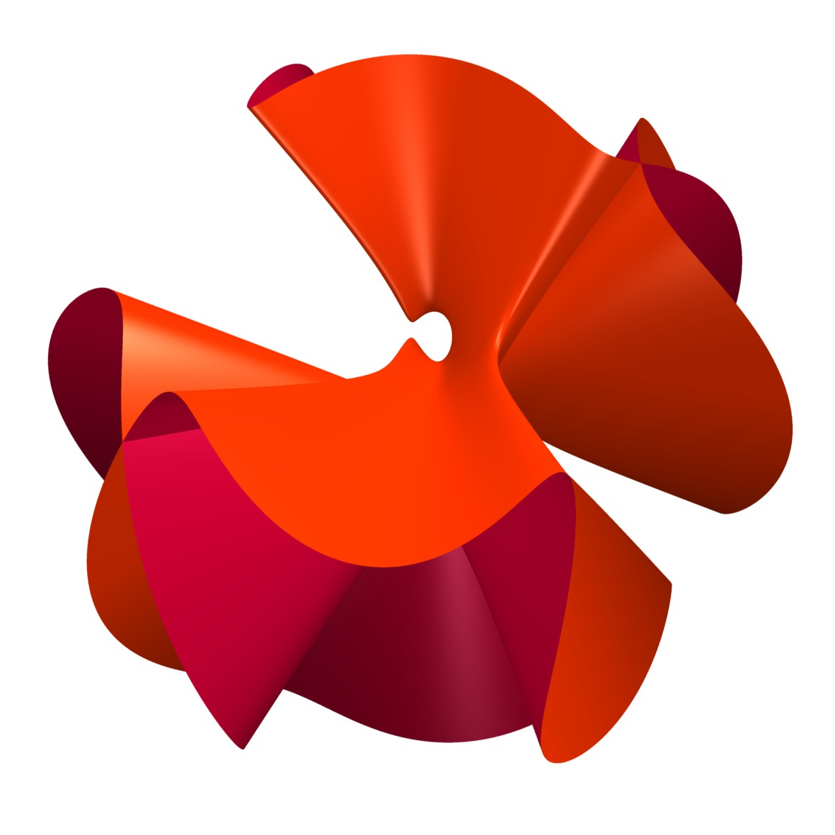
Some Slices of Fano Varieties

Slide 6
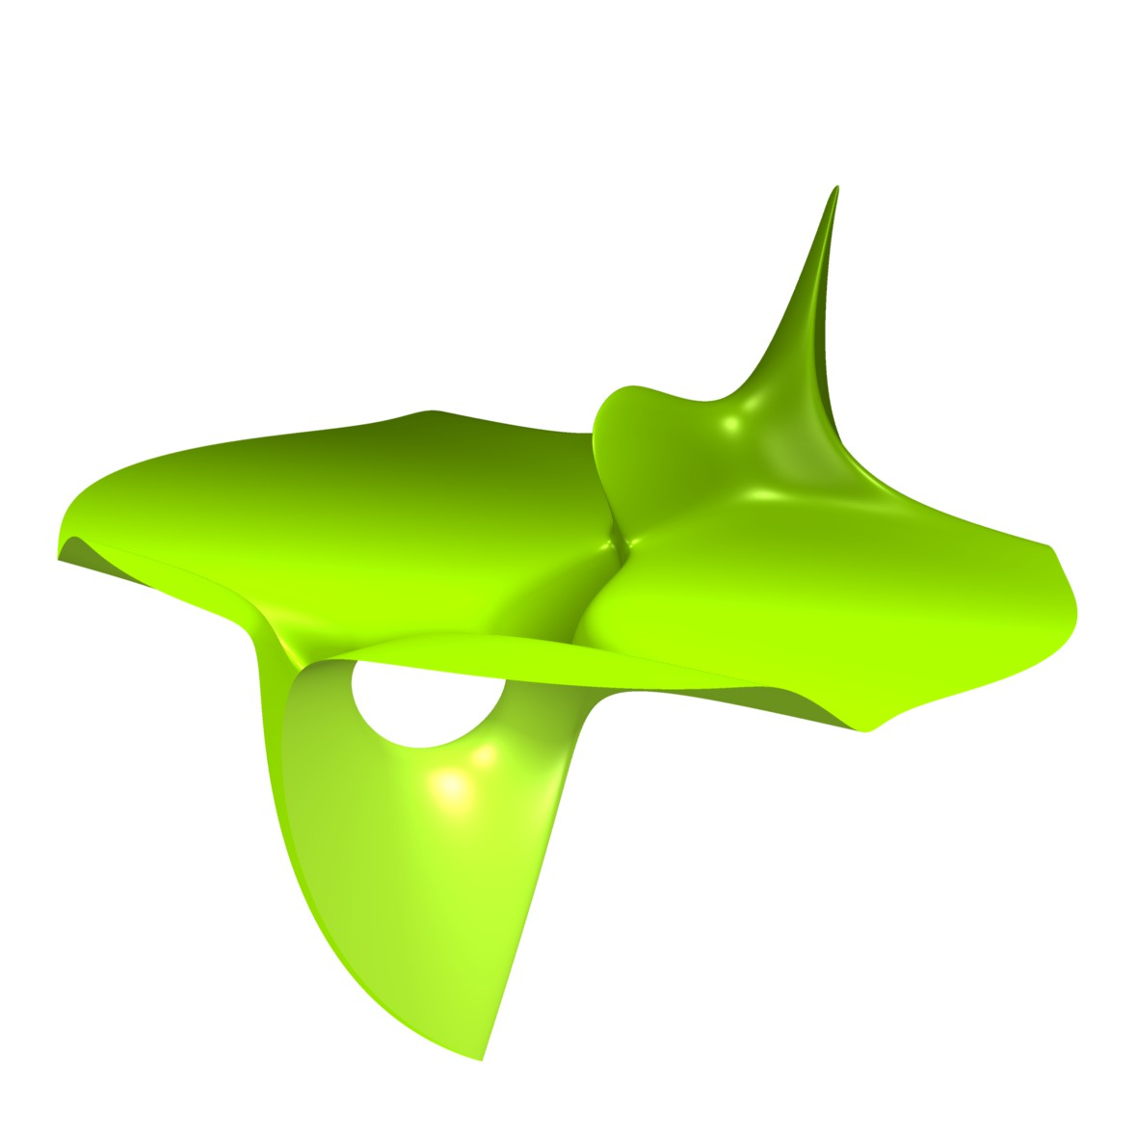
Some Slices of Fano Varieties

Slide 7
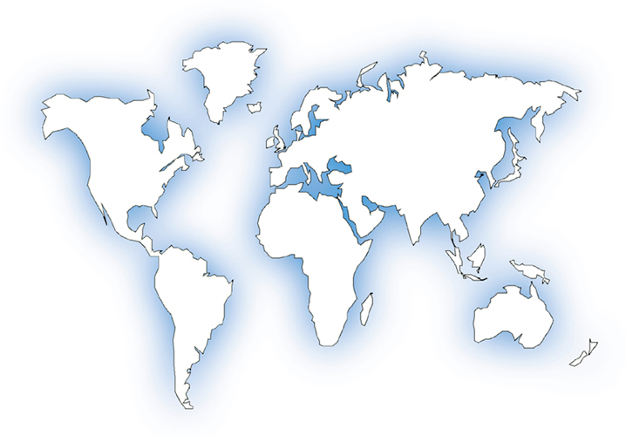
An International Team
•
•
•
Galkin
Coates
Corti
Kasprzyk
•
Golyshev
MAGMA

Slide 8
Many Collaborators
•
•
•
•
•
•
•
•
•
•
KYOTO
HAMBURG
BERLIN
WARWICK
GRENOBLE
VIENNA
BONN

Slide 9
Tools: Meatspace
face-to-face meetings
pencil-and-paper calculations
writing code, analyzing data
arguing at the blackboard

Slide 10
Tools: Like Water To Fish
Email | DropBox
Phone | www.arXiv.org
Skype | StackOverflow
IM

Slide 11
Tools: Web 2.0
Collaborative blog:
http://coates.ma.ic.ac.uk/fanosearch
sharing data
sharing ideas

Slide 12
Tools: Web 2.0
Twitter feed:
@fanosearch
results of computer calculations
public outreach

Slide 13
Thank you for your time

